Slide 1
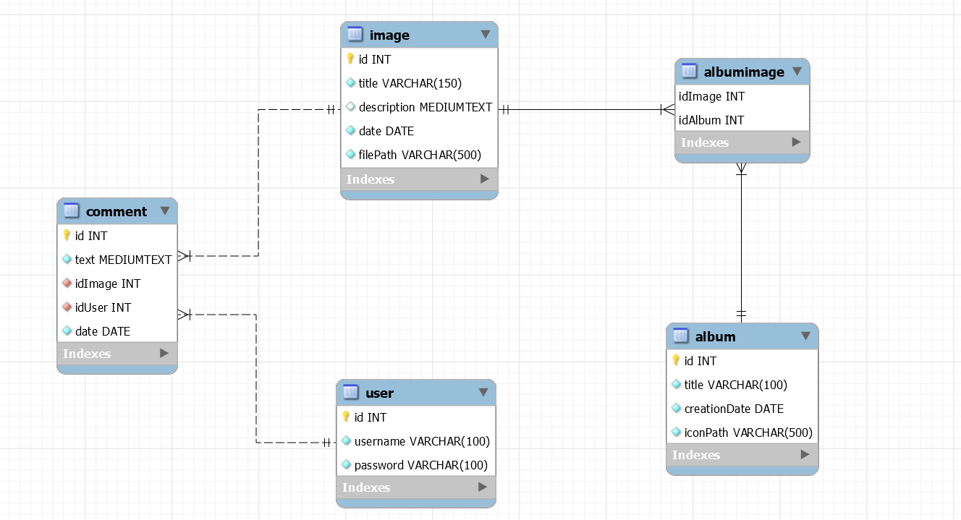
Database design

Slide 2
APPLICATION DESIGN
LOGIN PAGE
username, password
user -> session
Login form [field: username
field: password]
Check Login
submit
Registration form [field: username
Field: password
field: email]
albums
wrong user + pswd
HOME PAGE
submit
Wrong parameters/ status ok.
Check Login

Slide 3
user.id
album.id
Get albums list
Get Album Images
HOME PAGE
ALBUM PAGE
next, previous
:List
[databinding: image]
next
:List
[databinding: album]
select
select
previous
:Detail
[databinding: image]
image.id
album.id
Get Image Data
:List
[databinding: comment]
Create comment
:Form
[text comment, date]
Session.user!=NULL
submit
Text, image.id, user.id

Slide 4
Server side: DAO & model objects
Model objects (Beans)
User
Album
Comment
Image
Controllers (servlets)
CheckLogin (LoggedUser)
CheckGuest(Guest)
CreateComment (LoggedUser)
GetImagesOfAlbum (all)
Logout (LoggedUser)
NextImages (all)
PreviousImages (all)
OpenRegistrationForm (Guest)
Registration (Guest)
Filter
LoggedUser
GuestCheck
Data Access Objects (Classes)
UserDAO
checkCredentials(username, pwd)
createNewUser(username, pwd, email)
AlbumDAO
findAllAlbums()
findInfoOfAlbumById(userid)
ImageDAO
findImagesOfAlbum(albumId)
findImageById(imageId)
CommentDAO
findCommentsOfImage(imageId)
createComment(text, imageId, userId, date)
RegistrationDAO
createRegistrationOfUser(username,pwd,email)
controlRegistrationOfUser(userid)
Views (Templates) & components
Index (all)
Login form
Register form
AlbumList (all)
Album list
ImageList (all)
Image list
Image Details
Comment List
Comment Form

